Slide 1
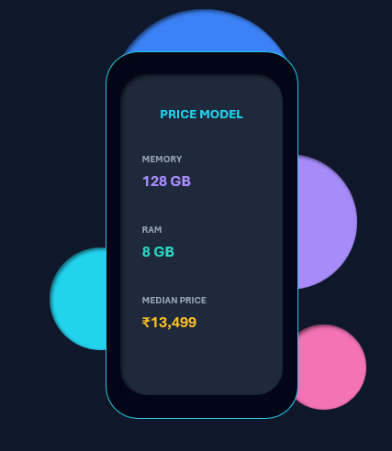
NextHikes IT Solutions
Mobile Price Prediction &
Feature Extraction
By Shiva Singh

Slide 2
Introduction:
In this project, we have worked with a dataset that contains detailed information about various Mobile phones, including their model, Color, Memory, RAM, Battery capacity, Rear camera specifications, Front camera specifications, presence of AI lens, Mobile height, Processor, and, most importantly, the Price. Our primary goal is to develop a predictive model for mobile phone prices.
We’ll perform a feature extraction analysis to identify the most influential features.
Objective:
Predictive Modeling: Develop an end-to-end machine learning solution designed to accurately estimate the market value of a mobile device using its features.
Feature Extraction: Execute mathematical and statistical feature extraction techniques to isolate and rank the most influential drivers of product pricing.
Pricing Strategy Optimization: Provide data-driven corporate insights to enhance target retail positioning and margins within a fiercely competitive tech landscape.

Slide 3
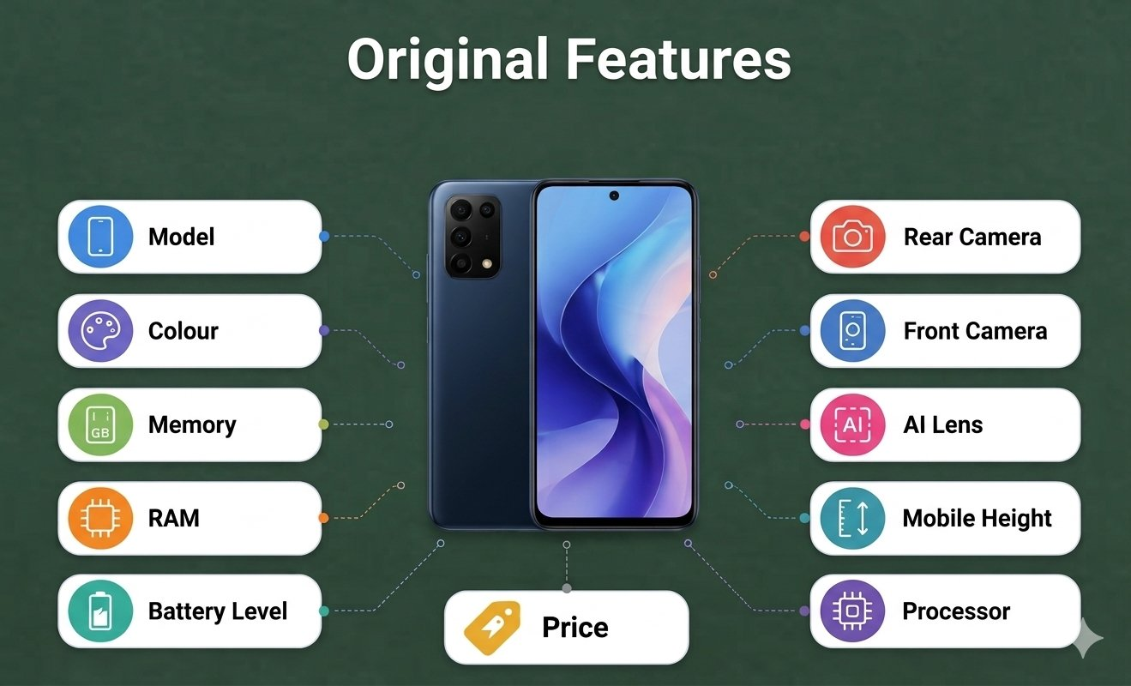
Dataset Overview
Original Features
Model
Colour
Memory
RAM
Battery Level
Rear Camera
Front Camera
AI Lens
Mobile Height
Processor
Price
Total rows = 541
Original Features = 11
Target Variable = Price

Slide 4
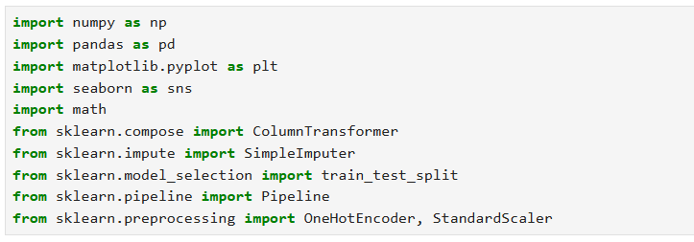
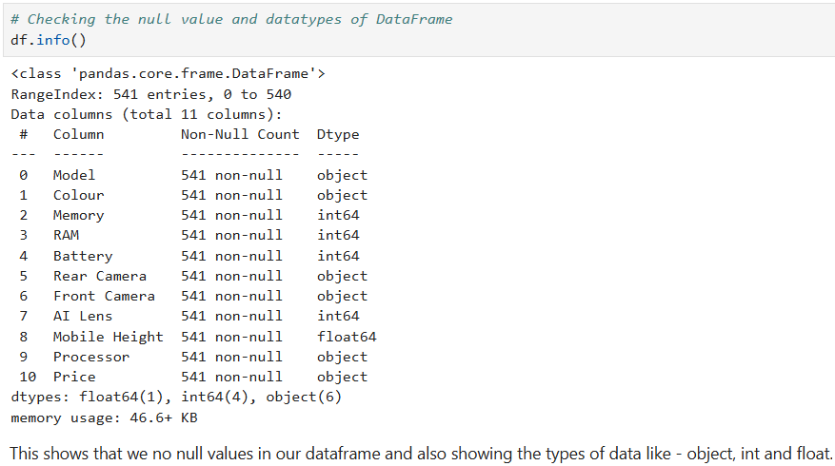
Importing the Important Libraries and Checking the information of dataset
In this step I explored the dataset to understand its structure, features, data types and overall quality before performing data cleaning and model building. I used functions such as head(), shape and info() to examine the dataset. I also checked for missing values and duplicate records. The dataset contains mobile specifications such as Memory, RAM, Battery, Rear Camera, Front Camera, AI Lens and Mobile Height while Prize represents the target variable that needs to be predicted. This initial analysis helped me identify the preprocessing and feature engineering steps required before training the machine learning models.

Slide 5
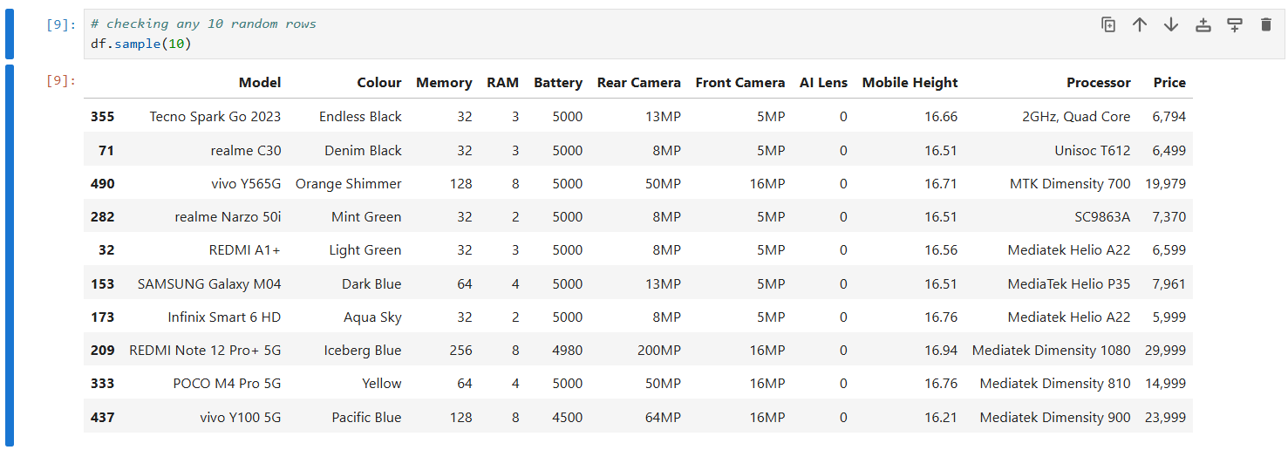
Checking the any 10 rows

Slide 6
Numerical Columns
Categorical Columns
Data Cleaning
Memory
RAM
Battery
AI Lens
Mobile Height
Price
Rear Camera MP
Front Camera MP
Model
Colour
Rear Camera
Front Camera
Processor
In the data cleaning stage, Need to start by checking the dataset for duplicates, missing values, and data types. To get ready for feature engineering, removed unnecessary columns, converted camera details into numbers and cleaned up text categories like processor, color and model.

Slide 7
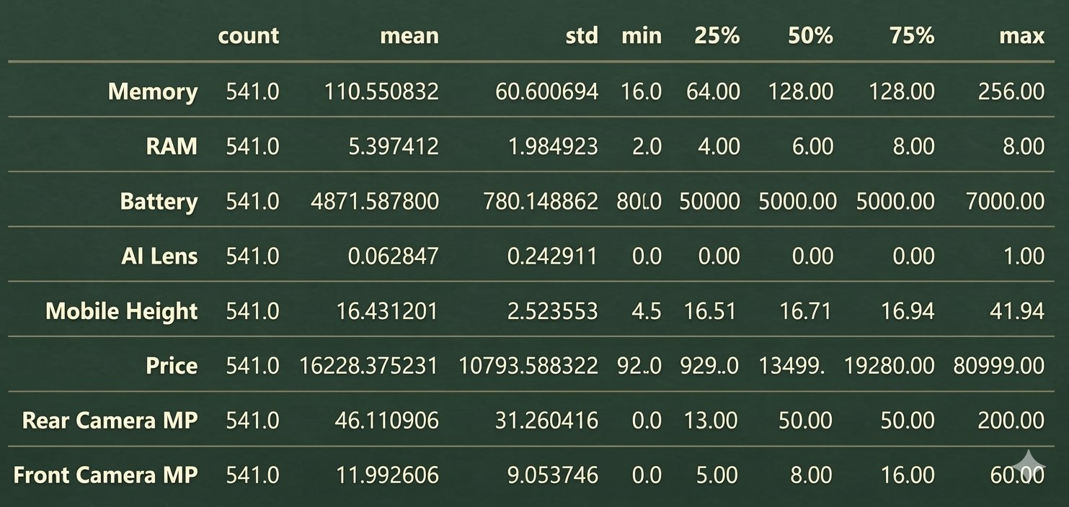
Statistical Analysis Techniques
The statistical analysis shows that the dataset contains 541 rows. Memory ranges from 16 to 256 GB, RAM from 2-8 GB, Battery from 800-7000 mAh, AI Lens is a binary feature, while mobile Height shows some extreme values that may need further investigation.

Slide 8
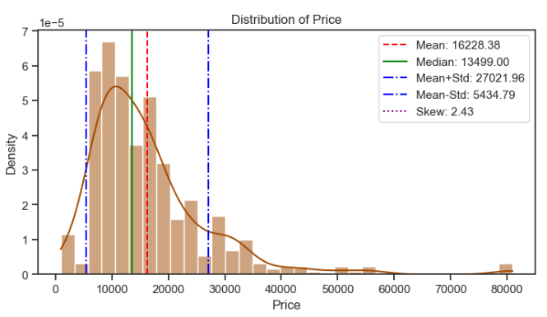
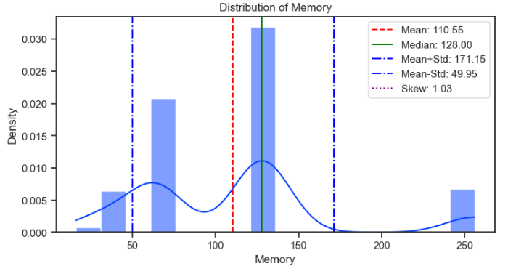
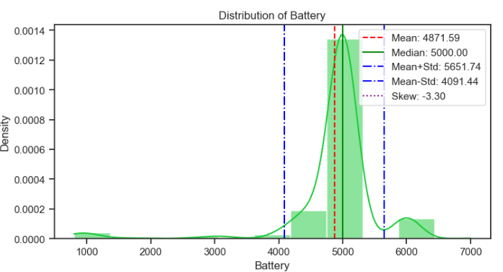
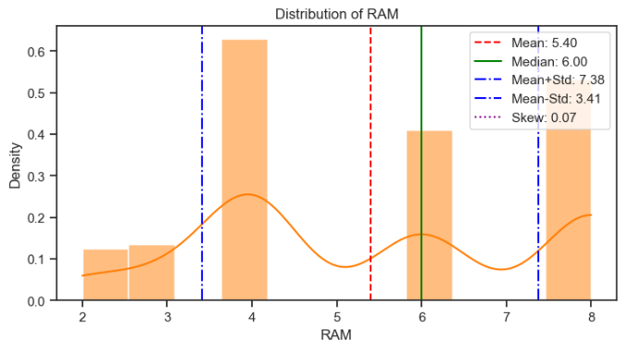

Slide 9
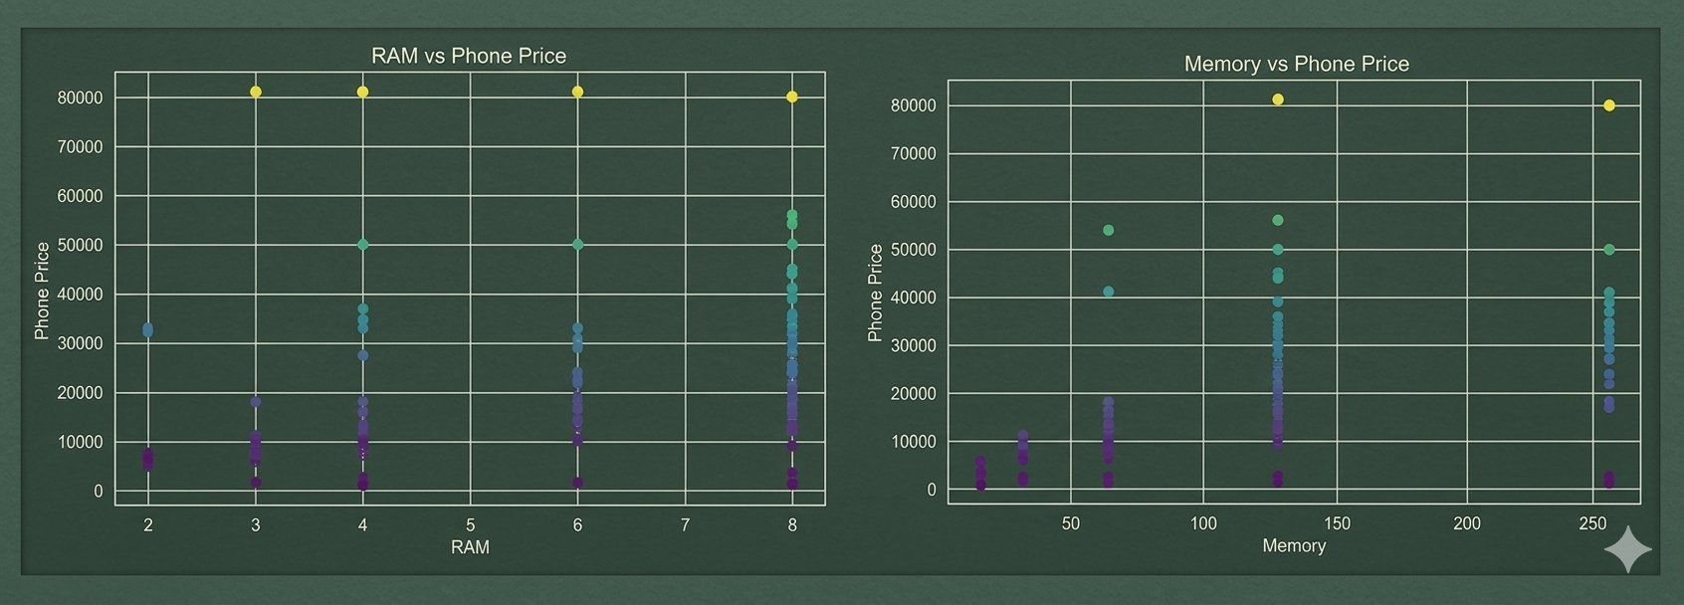
Bivariate Analysis of RAM and Memory Vs Price
RAM – Higher RAM leads to more expensive phones because it allows device to handle applications and multitask
Smoothly. This shows positive price trend hold true within our actual dataset.
Memory - A pattern of increasing prices with higher memory would suggest a positive relationship between storage
and price. However, phones with the same storage capacity may have different prices because of other specifications.

Slide 10
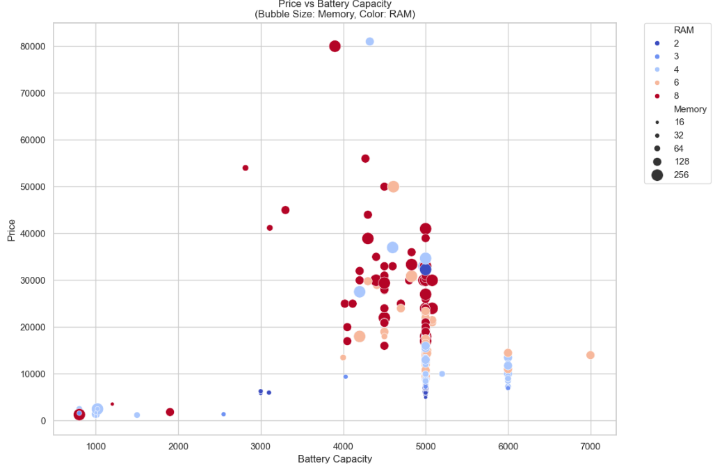
Multivariate Analysis - Price vs. Battery, RAM, & Memory
Standard Batteries: Large batteries are standard across almost all phones.
Budget Exception: Small batteries are found only in the cheapest phones.
Cost Drivers: Premium pricing is driven by high RAM and massive storage.
Mid-Range Sweet Spot: The 10,000–20,000 range pairs large batteries with mid-tier specs.
Premium Formula: Phones over 25,000 combine maximum battery with top-tier RAM and storage.

Slide 11
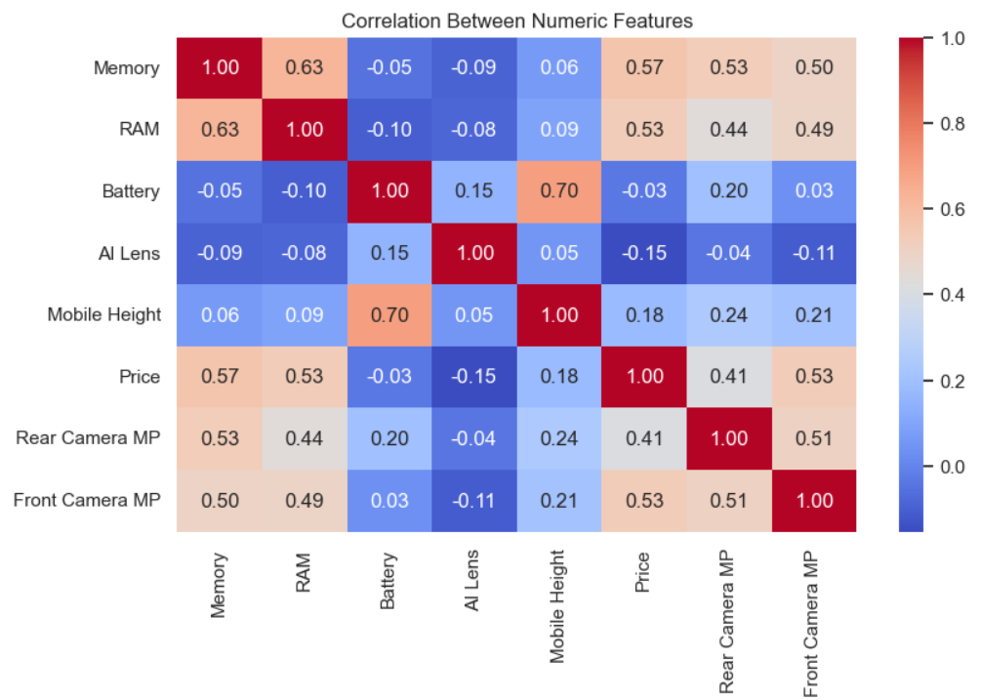
Correlation Analysis
Taller phones directly fit larger batteries due to their increased physical size. Also Phone's price is mostly driven up by three key premium specs: more memory, higher RAM, and a better front camera. These performance features frequently increase together as phones get more advanced. Conversely, the AI lens feature stands out by actually dropping slightly as prices rise.

Slide 12
07
Feature Extraction and Encoding
Camera fields contain text such as “50MP”. Regular Expressions extract the numeric portion and create machine-readable features.
RAW CAMERA FIELD
→
REGEX EXTRACTION
→
NUMERICAL FEATURE
50MP
([\d.]+)
50
Camera feature creation
One-hot encoding
Rear Camera MP • Front Camera MP
Create indicator columns for categorical values such as processor or colour.
We cleaned the price column and used regex to extract numeric megapixels from the Rear & Front Camera fields. One-hot encoding was then applied to the categorical features, converting text labels into binary columns so the machine learning models could process them without assuming an incorrect order or ranking.
7

Slide 13
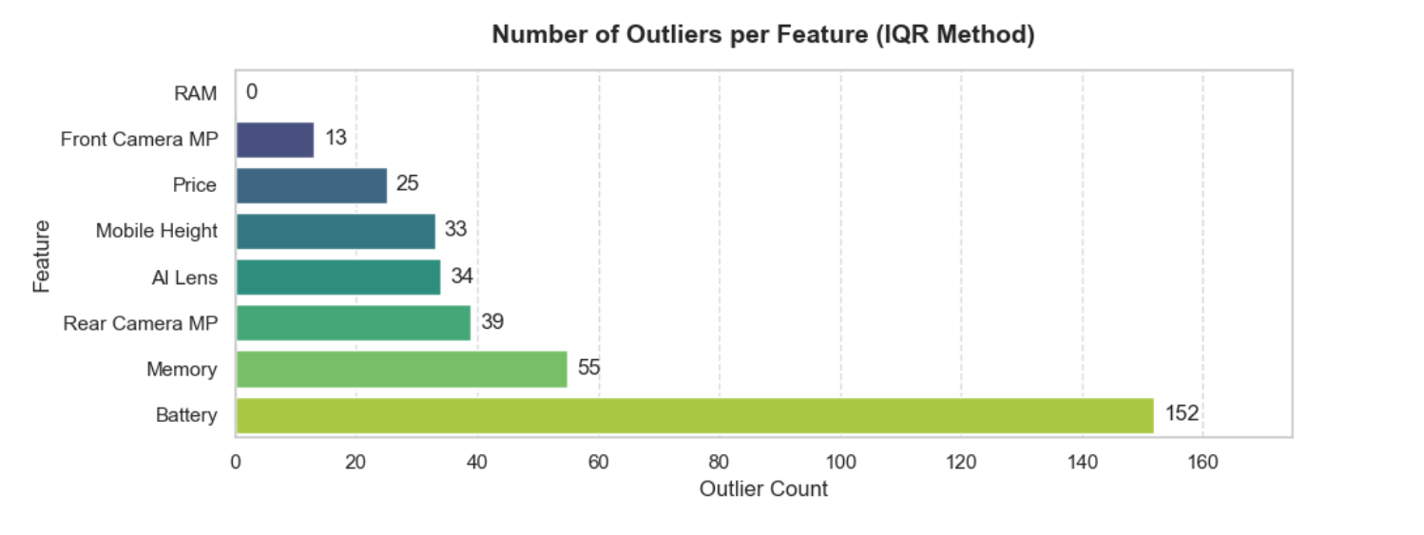
Checking Outliers

Slide 14
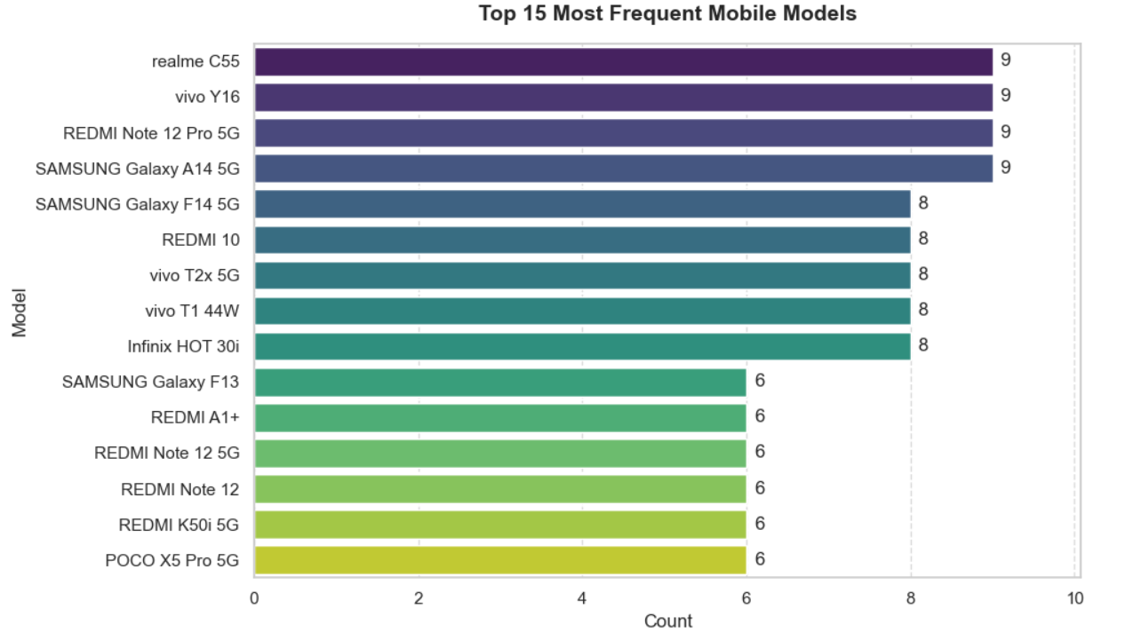

Slide 15
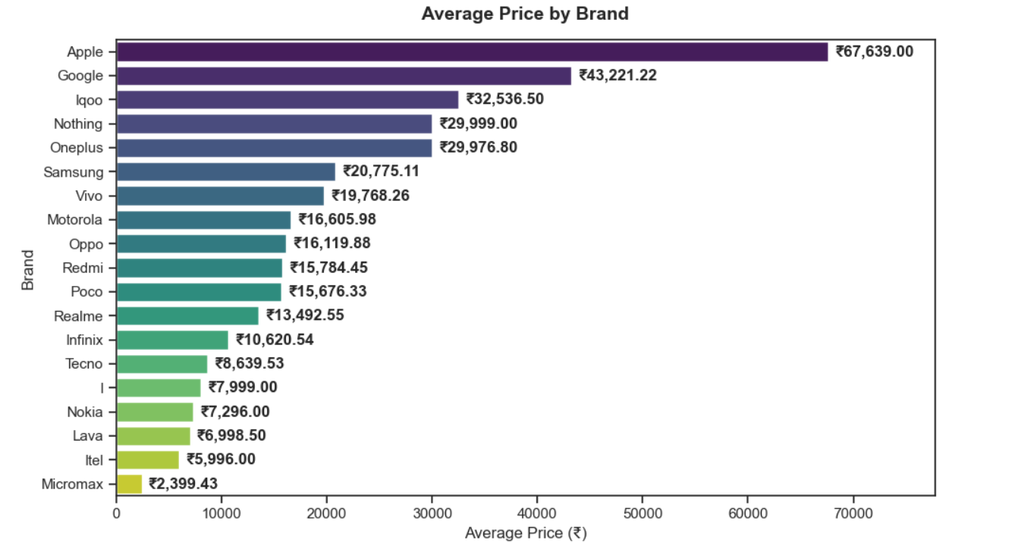
This graphs shows Apple as the highest average price.

Slide 16
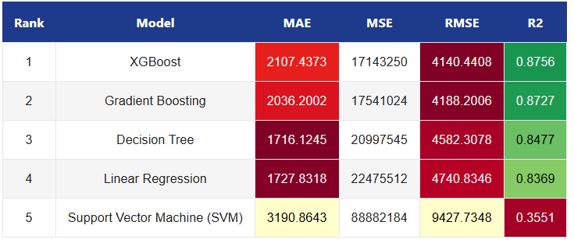
Model Evaluation Matrix
XGBoost delivered the best mobile price predictions, leading the evaluation with a top R² score of 87.56% and the lowest overall error (RMSE: 4,140.44). Conversely, Support Vector Machine (SVM) performed exceptionally poorly, capturing only 35.51% of variance due to extreme error margins.

Slide 17
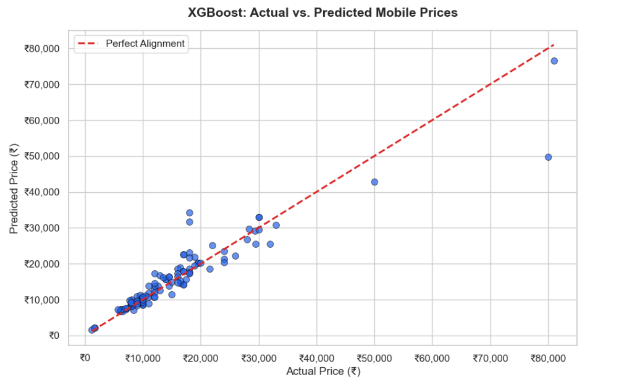
Comparison with Actual and Predicted Mobile phone Prices

Slide 18
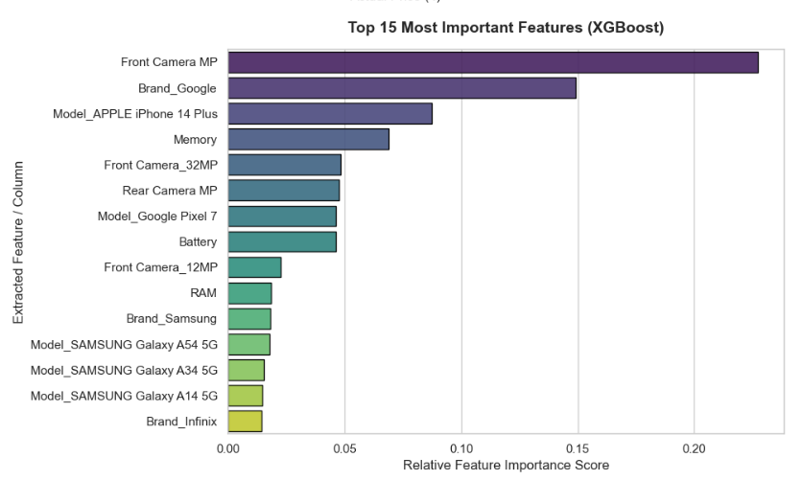
Key Notes : Front Camera MP and premium branding (Google and Apple iPhone 14 Plus) are the primary drivers of mobile phone pricing, carrying the highest relative feature importance scores. Technical specifications like Memory, Battery, and RAM have a minor, secondary impact on the final price predictions.

Slide 19
Final Conclusion
Performance Snapshot: The XGBoost Regressor is the project champion, explaining 87.56% of pricing variance with a tight average error (RMSE) of ₹4,140.00.
Architectural Advantage: It outperformed linear frameworks by handling complex non-linear feature interactions, applying regularization to block overfitting, and seamlessly processing mixed data types.
Feature Engineering: Market value is primarily dictated by unset Front Camera MP as a tier gatekeeper, high-end brand modifiers isolating luxury markups, and internal unset Memory out-weighting unset RAM .
Diagnostic Limitations: Predictions are highly precise for mass-market tiers (₹5,000–₹35,000), but the model under – predicts speculative luxury flagships and over-predicts aggressive "flagship killer" outliers.
Deployment Readiness: The model is fully production-ready, compiled into a serialized pipeline (unset best_xgboost_mobile_model.pkl ) that encapsulates all preprocessing steps for live inference.

Slide 20
Business Recommendation
Our champion XGBoost pricing model drives high-impact operational strategies across procurement, monetization, and live market operations. Supply chain teams should utilize Front Camera MP specs as a primary velocity gatekeeper to accurately size inventory tiers across entry, mid, and premium sectors.
Marketing and production focus must pivot toward upselling internal storage (Memory) over incremental RAM steps to capture the steeper, high-margin retail markups confirmed by the data.
Furthermore, secondary marketplace appraisal engines must embed a structural luxury brand value multiplier to properly offset slower physical depreciation rates. Retail acquisition campaigns should targetedly exploit high-arbitrage "flagship killer" anomalies around the ₹18,000 retail bracket to rapidly build customer volume.
Finally, embedding this automated pipeline into live marketplace arrays enables real-time dynamic market pricing to automatically capture market arbitrage and instantly flag underpriced competitor stock.

Slide 21
Thank You

